Slide 1

Smart IoT & ML System for Food Monitoring
C-13
22AIE213 Machine Learning 22AIE211 Introduction to IOT
Team Members | Registration No
K S Venkatram | CB.SC.U4AIE23236
Sanggit Saaran K C S | CB.SC.U4AIE23247
Vishal Seshadri B | CB.SC.U4AIE23260
Surya HA | CB.SC.U4AIE23267
1

Slide 2
Introduction
Food wastage and inefficient storage management are significant challenges caused by manual tracking, resulting in spoilage and higher costs.
Our project introduces a smart IoT and ML system for automated food monitoring, reducing the need for human intervention.
RFID-based tracking ensures real-time inventory logging, while ML-driven image recognition predicts spoilage patterns.
Environmental sensors monitor temperature and humidity, preventing premature food deterioration.
LLM generates personalized recipes based on available ingredients, helping reduce waste and improve convenience.
2

Slide 3
Literature Review
S.no | Title and Year | Key Contribution | Limitation
1 | Smart refrigerator: An IOT and machine learning based approach (Mallikarjun et al., 2020) | IoT sensors and OpenCV detect vegetables, suggest recipes | K-means lacks robustness in complex or mixed food images
2 | Internet of things-based (IoT) inventory monitoring refrigerator using arduino sensor network (Jessica Velasco et al., 2019) | Wireless monitoring of compartments through smartphone and microcontrollers | No image-based food recognition or spoilage detection included
3 | IoT Based Smart Refrigerator for Food Management System (Kiran B et al., 2024) | Real-time image processing and gas-based spoilage detection | Lacks machine learning-based food classification or recipe suggestions
4 | Smart fridge for global users based on IOT using deep learning (Avinash N.J et al., 2020) | CNN classifies and detects spoiled food using sensors | No mobile interface or inventory tracking provided
3

Slide 4
S.no | Title and Year | Key Contribution | Limitation
5 | IoT Based Smart Refrigerator Using Machine Learning (Devanath B et al., 2024) | CNN detects fridge contents using Raspberry Pi and sensors | Limited to object detection; lacks freshness prediction logic
6 | Using IoT and AI to replenish household food supplies: A systematic review (Almassar K.M et al., 2024) | Reviewed IoT-AI systems using PRISMA, identified core components | No practical implementation or empirical validation of findings
7 | Smart refrigerator based on ‘internet of things’ (Gupta S et al., 2021) | Weight and temperature tracked via sensors, mobile app support | No AI or ML model for freshness or classification
8 | Smart food monitoring system based on iot and machine learning (Md. Johirul Islam Tutul et al., 2023) | ML predicts spoilage using gas, temperature, humidity sensors | Limited generalization across food types and real-world settings
9 | IoT-based Food Quality Monitoring System Using Machine Learning (R. Vasanthi et al., 2024) | Logistic Regression best in multi-sensor freshness classification | Accuracy (80%) insufficient for high-reliability food monitoring
4

Slide 5
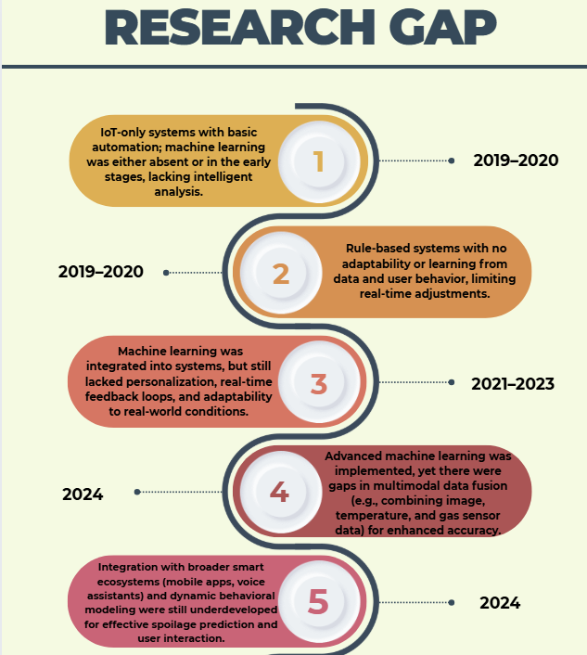
Research Gap
5

Slide 6
Objective
IoT-enabled Smart Refrigerator for real-time food tracking and freshness monitoring.
Automated Inventory Management – Improved real-time food tracking with RFID, ensuring seamless inventory updates.
Intelligent Spoilage Detection – Machine learning-driven image recognition for better spoilage detection.
Optimized Storage Conditions – Continuous temperature and humidity monitoring prevents premature food deterioration.
Remote Accessibility & Monitoring – Remote monitoring via cloud integration, enabling users to track inventory.
LLM-Powered Recipe Generation – LLM-generated personalized recipes by analyzing available ingredients, prioritizing expiring items, nutrition, and cooking difficulty.
6

Slide 7
Problem Statement
Food spoilage and wastage continue to be significant global challenges, largely driven by inefficient storage monitoring, lack of real-time inventory tracking, and the absence of intelligent decision-support systems in household and commercial refrigeration units. Existing IoT-based solutions often provide only rudimentary sensor data without intelligent classification, while machine learning-based models struggle with real-time integration, personalization, or adaptability to resource-constrained environments.
To address these limitations, this work proposes an integrated IoT and machine learning-based smart food monitoring system that can:
Classify food items and detect spoilage using lightweight CNNs (MobileNetV2) and SVM classifiers. Monitor environmental parameters such as temperature and humidity using DHT22 sensor.
Track inventory using RFID modules in real time. Predict food expiration using Random Forest. Suggest context-aware recipes through an LLM-powered module to reduce food wastage.
7

Slide 8
Methodology
Random Forest Model:
Dataset Preparation: The dataset consists of temperature and humidity values recorded from the DHT22 sensor, along with a corresponding label Condition indicating whether the environment is suitable (0) or unsuitable (1) for food storage.
Feature and Label Extraction: The two environmental features — Temperature (°C) and Humidity (%) — are extracted as inputs (X), while the Condition column is used as the target output (y).
Model Selection and Training: A Random Forest Classifier was chosen for its robustness and ability to handle non-linear relationships. The model was trained with 100 decision trees (n_estimators=100).
Model Deployment: After training, the model is saved using joblib as try_condition_model.pkl, allowing for seamless deployment into the IoT system for real-time condition prediction based on sensor inputs.
8

Slide 9

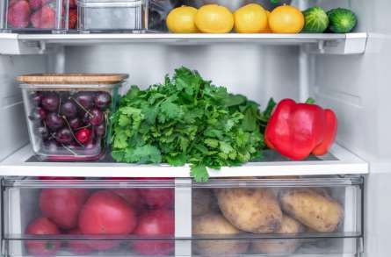





Methodology
MFRC522 RFID sensor
+ DHT22
TEMPERATURE sensor
⚬RFID sensor tracks food` items, while the temperature and humidity sensor ensures proper storage conditions.
ML MODEL
⚬CNN-based spoilage detection and Freshness detection. Random forest model with temperature data.
WEB INTERFACE
⚬Displays inventory, storage conditions, expiry alerts, and
recipe suggestions for easy user access.
INVENTORY
⚬Stores food items and Monitors storage conditions and transmits data to the cloud.
IP WEBCAM
⚬Captures food images for CNN based spoilage
detection.
DATABASE
⚬Stores food details and sensor data in Supabase.
9

Slide 10
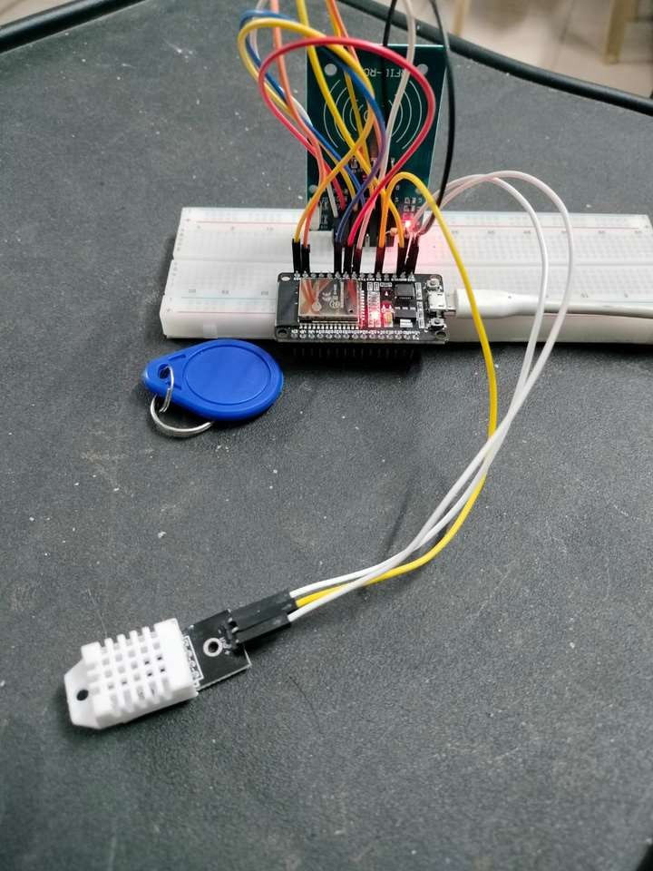
Methodology
Temperature and Humidity Monitoring:
The DHT22 sensor is employed to capture temperature and humidity data within the storage unit. Which is crucial for maintaining food freshness and preventing spoilage.
Real-Time Data Collection:
The sensor is connected to the ESP32 microcontroller, which collects data at regular intervals. This continuous monitoring enables timely alerts and status updates.
Storage Condition Evaluation:
The system checks whether the recorded temperature and humidity values fall within predefined safe ranges. If the conditions deviate, alerts are generated to warn the user.
Visual Monitoring via IP Webcam:
IP Webcam is used for capturing the images of the food items, which then is used for the freshness detection.
10

Slide 11
Methodology
RFID-Based Item Identification:
Each food item is tagged with a passive RFID tag, which is detected by the MFRC522 RFID module. This enables automatic identification of items upon scanning.
Backend Integration and API Communication:
The microcontroller communicates with a backend server via HTTP REST APIs. Real-time data from sensors is transmitted for processing and visualization.
Live Status Updates to Frontend:
The system ensures that any changes in inventory—such as adding or removing an item—are instantly reflected in the web application, keeping the user informed.
11

Slide 12
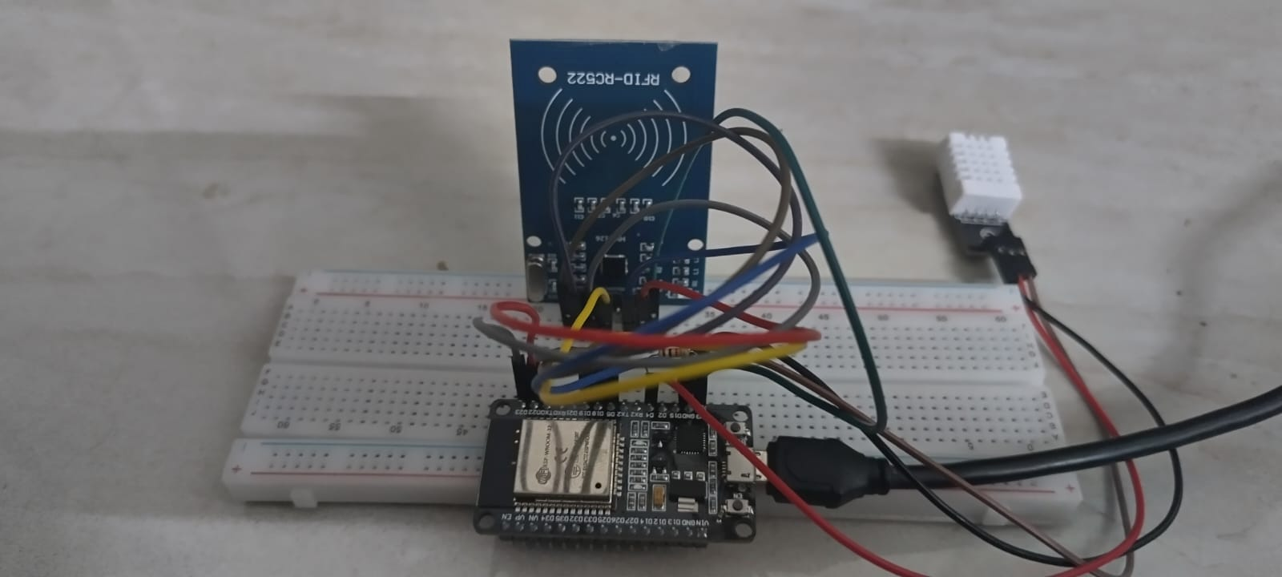
Methodology
RFID reader modules operate by emitting a short-range radio frequency signal that activates passive RFID tags attached to food items.
Upon activation, each tag transmits its unique identifier, which is captured and sent to the microcontroller for processing.
The microcontroller matches tag data with the inventory database, triggering updates such as addition, removal, or timestamp logging of items.
12

Slide 13
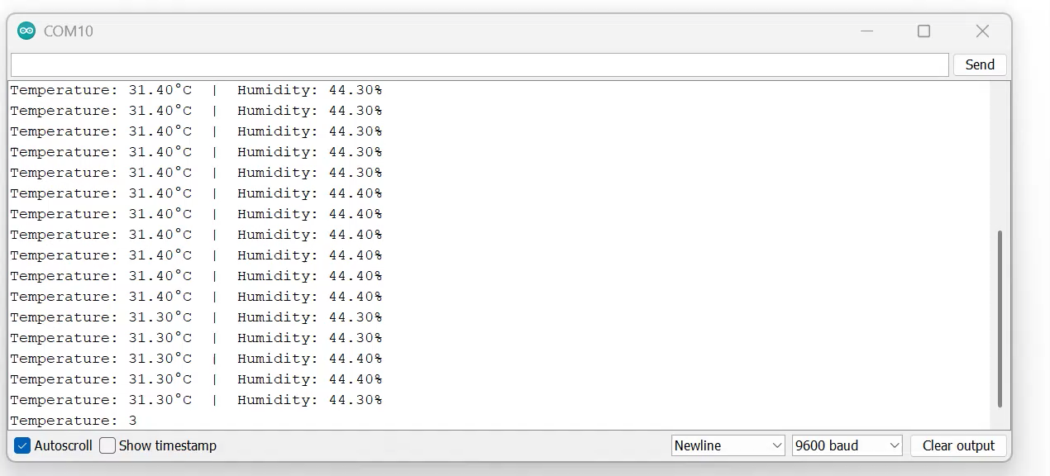
Methodology
Combined RFID module and DHT22 sensor with ESP32
microcontroller, simultaneous
achieving real-time
Inventory tracking for individual food products and storage monitoring through temperature and humidity readings
13

Slide 14
Methodology
Dataset Organization and Preprocessing:
The model is trained using the publicly available Fruits and Vegetables Dataset, which contains approximately 12000 images divided into two high-level categories—Fruits and Vegetables. Each subfolder represents specific food types and their freshness (e.g., FreshApple, RottenApple).
Image Selection: To maintain class balance and reduce computational overhead, 400 images were selected per class.
Label Encoding:
Freshness Detection: Binary labels were assigned (0 = Fresh, 1 = Rotten).
Food Type Classification: Multi-class labels were assigned using folder indices.
Image Preprocessing: All images were resized to 224×224 pixels, conforming to the input dimensions required by MobileNetV2.
14

Slide 15
Methodology
Feature Extraction Using MobileNetV2
MobileNetV2, pretrained on the ImageNet dataset, is used as a feature extractor. Its efficient architecture makes it suitable for deployment on low-resource IoT devices.
The classification layers of MobileNetV2 are removed to utilize only the convolutional base, allowing the model to extract meaningful features without performing final classification.
All images are resized to 224×224 pixels and normalized to match the expected input shape and format for MobileNetV2, ensuring consistent and accurate feature extraction.
The final output from the model’s convolutional layers is flattened into a one-dimensional vector, which serves as the input to SVM model.
15

Slide 16
Methodology
Support Vector Machine (SVM) for Classification
Ensuring Freshness Detection with SVM
Robust Classification Model – Implemented an SVM classifier with an RBF kernel to effectively distinguish between fresh and spoiled food items.
Enhanced Accuracy – Leveraged deep feature representations from CNN to improve the model’s ability to classify food freshness.
Accurate Food Type Identification
Multi-Class Classification – Trained an additional SVM model to categorize different fruits and vegetables based on extracted features.
Model Storage for Future Use – Successfully saved trained Models: Fresh vs. Rotten Classifier (fresh_vs_rotten_svm_model.pkl) Food Type Classifier (food_type_svm_model.pkl) Feature Extraction Model (food_categories.pkl)
16

Slide 17
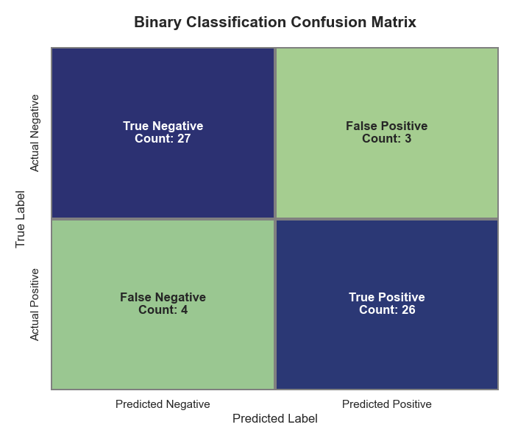
Results
Model 1 (Fresh vs Rotten Classification)
High Accuracy in Classification:
The model correctly identified 27 rotten items (True Negatives) and 26 fresh items (True Positives), showing strong classification ability.
Low Misclassification Rate:
Only 3 rotten items were misclassified as fresh (False Positives), and 4 fresh items were misclassified as rotten (False Negatives), indicating minimal error.
Robust Performance:
With a balanced accuracy of 88.33%, precision, recall, and F1-score, the model proves to be reliable for real-time food freshness monitoring.
Effective Real-World Utility:
The model’s strong performance ensures that it can be confidently used in smart kitchen systems to reduce spoilage and assist users in food management.
17

Slide 18
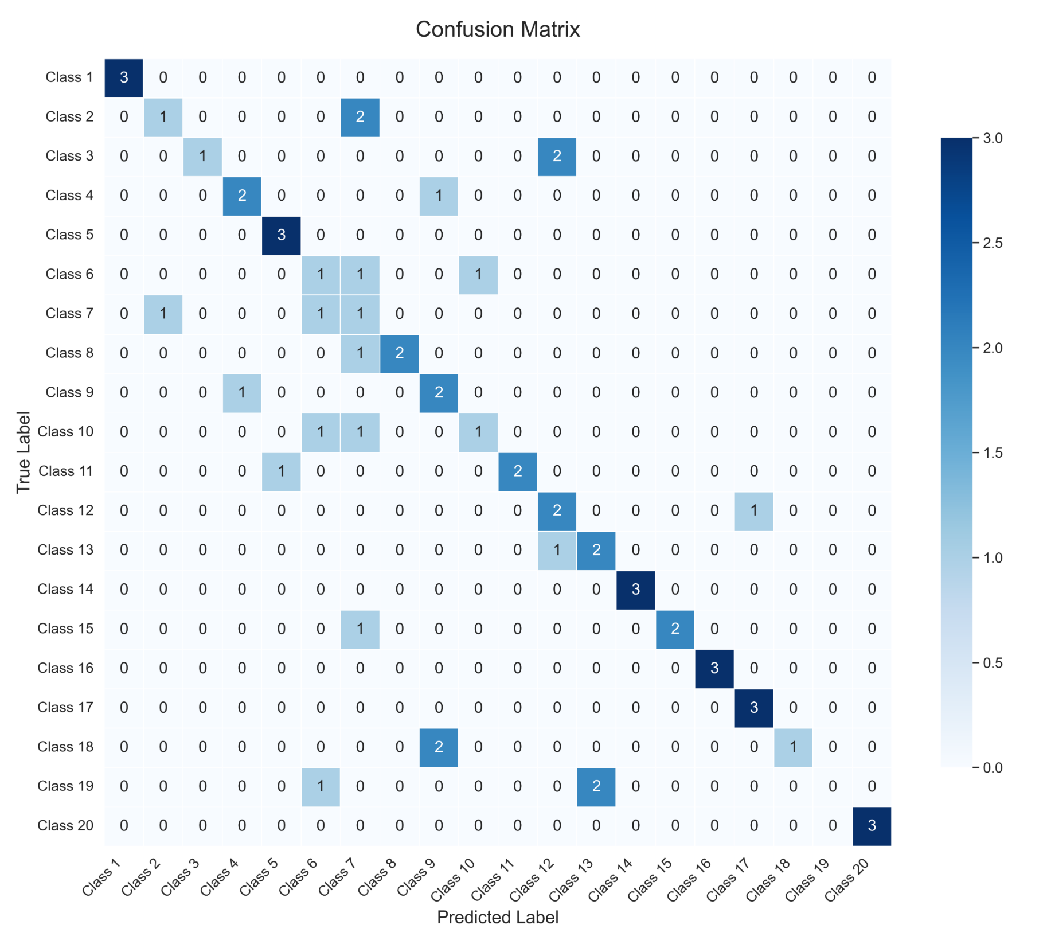
Results
Model 2 (Multi-Class Food Classification)
Multi-Class Accuracy with Highlights:
The model successfully classified several classes perfectly (e.g., Class 1, 5, 14, 16, 17, 20) with no misclassifications, showing strong class-specific learning.
Misclassification Trends:
Some confusion is observed among visually or semantically similar classes such as Class 2, 7, 10, 13, indicating possible overlap in features due to image similarity or data imbalance.
Outset of Model:
Overall, the model shows potential in recognizing diverse food spoilage types but would benefit from increased training data and enhanced feature differentiation for finer classification accuracy.
18

Slide 19
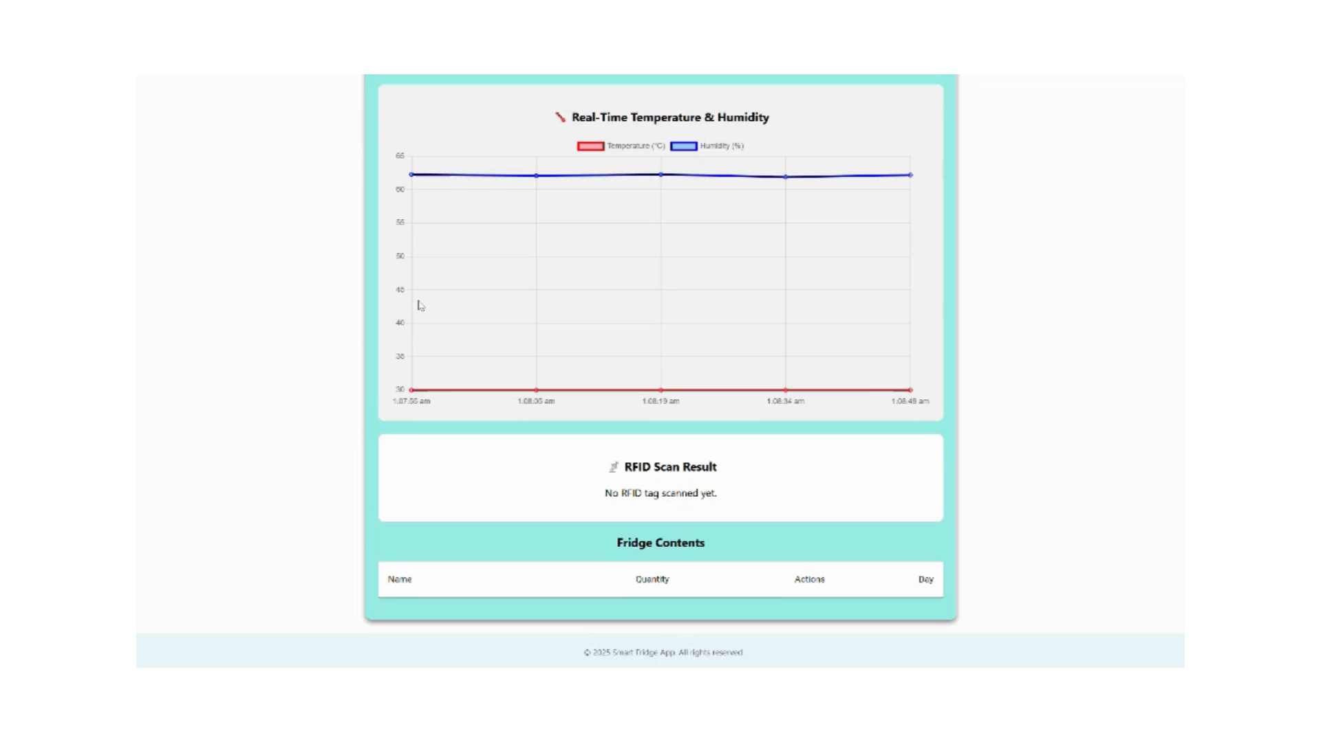
Working
19

Slide 20
Limitation and Future scope
Limited Dataset Variety: The current machine learning model is trained on a relatively small dataset with limited food categories and environmental scenarios. This restricts the system's ability to generalize across diverse household conditions.
Expansion to Multimodal Monitoring: Future enhancements can include integrating image recognition and gas sensors alongside temperature and humidity for a more comprehensive food quality analysis.
Personalized User Interaction: The system can be updated to offer customized suggestions based on user preferences, dietary patterns, and consumption habits to reduce waste more effectively.
Mobile and Voice Assistant Integration: Adding mobile app support and smart assistant compatibility (e.g., Alexa, Google Assistant) will enable seamless control and real-time notifications.
Adaptive Learning Capabilities: Incorporating reinforcement learning will allow the system to dynamically adapt to user behavior and inventory usage over time.
20

Slide 21
Conclusion
This project introduced a smart, ML-powered IoT refrigerator system aimed at reducing food waste and improving storage efficiency. By automating environmental monitoring and inventory tracking, the system minimizes the need for manual oversight.
Machine learning models help predict food spoilage patterns, enabling timely interventions. RFID and sensor data integration ensures accurate, real-time insights into food conditions. The recipe recommendation feature adds a user-centric touch by encouraging creative and mindful consumption. Together, these components contribute to a more sustainable and intelligent kitchen environment.
21

Slide 22
References
[1] Mallikarjun, B.C., Harshitha, S., Harshita, B.K., Bhavani, S. and Tarwey, S., 2020, June. Smart refrigerator: An IOT and machine learning based approach. In 2020 international conference for emerging technology (INCET) (pp. 1-4). IEEE.
[2] Velasco, J., Alberto, L., Ambatali, H.D., Canilang, M., Daria, V., Liwanag, J.B. and Madrigal, G.A., 2019. Internet of things-based (IoT) inventory monitoring refrigerator using arduino sensor network. arXiv preprint arXiv:1911.11265.
[3] Kiran, B., Yadav, D.K., Dalvi, O.S., Bin, D.S. and Raghu, N., 2024, December. IoT Based Smart Refrigerator for Food Management System. In 2024 International Conference on Emerging Research in Computational Science (ICERCS) (pp. 1-7). IEEE.
[4] Avinash, N.J., Pinto, R., Bhat, S., Chetan, R. and Moorthy, H.R., 2020, December. Smart fridge for global users based on IOT using deep learning. In 2020 International Conference on Power, Energy, Control and Transmission Systems (ICPECTS) (pp. 1-4). IEEE.
22

Slide 23
[5] Devanath, B., Dharunish, A.P., Mohana Bharathi, S., Suganth, R., Banupriya, V. and Ramesh, M., 2024, March. IoT Based Smart Refrigerator Using Machine Learning. In 2024 2nd International Conference on Artificial Intelligence and Machine Learning Applications Theme: Healthcare and Internet of Things (AIMLA) (pp. 1-6). IEEE.
[6] Almassar, K.M. and Khasawneh, M.T., 2024. Using IoT and AI to replenish household food supplies: A systematic review. Journal of Smart Cities and Society, 3(1), pp.23-62.
[7] Gupta, S., Giri, S., Srivastava, T., Agarwal, P., Sharma, R. and Agrawal, A., 2021, March. Smart refrigerator based on ‘internet of things’. In 2021 International Conference on Advance Computing and Innovative Technologies in Engineering (ICACITE) (pp. 436-439). IEEE.
[8] Tutul, M.J.I., Alam, M. and Wadud, M.A.H., 2023, June. Smart food monitoring system based on iot and machine learning. In 2023 International Conference on Next-Generation Computing, IoT and Machine Learning (NCIM) (pp. 1-6). IEEE.
[9] Vasanthi, R., Ashika, K. and Archana, D., 2024, April. IoT-based Food Quality Monitoring System Using Machine Learning. In 2024 2nd International Conference on Networking and Communications (ICNWC) (pp. 1-7). IEEE.
23

Slide 24
THANK
YOU
24

